Slide 1


自我介紹
Paul Dai
2025年3月
Notes:
Before we start, I want to thank you (all) for being here.
It’s my pleasure to introduce myself to you.

Slide 2
目錄
1
自我介紹
2
專案 1 - 數位轉型策略對齊
# 策略規劃、DX、流程優化、Brown Paper、跨部門溝通
3
專案 2 - Google - GMO Eureka 平台
# 儀表板、資料平台、實體關係圖、資料管道、GCP
4
專案 3 - 人工智慧整合遊戲
# AI 應用、擴散模型、推薦
5
專案 4 - 費用申請系統（EAS）
# 財務規劃與分析、企業資源規劃、儀表板、VBA、利潤中心、流程優化
6
專案 5 - LLM 申請：ChatGPT x 企業資料庫
# LLM、Chatbot、MCP、流程自動化、text2SQL、PPT 翻譯器
7
專案 6 - 數位行銷關鍵績效指標追蹤儀表板
# 儀表板、需求分析、AWS、數位行銷、衝突管理
Notes:
I’ll present for 20 mins:
First part, it’s about my background
The second part we have some project demos.
Because the limitation of our time, I think you could choose 1 or 2 case, and I’ll present that to you.
So, let me quickly go through all of them.
The 1st one is an AI model, going to predict the daily sales
The 2nd is data analysis case study, trying to find marketing strategies to enhance their members
3rd is an dashboard project, how I used AWS architecture to build dashboard.
4th is an expense reimbursements application system, that is a case I used VBA, SQL to help a start-up to build their expense application system.
Last one is an digital transformation strategies alignment, we helped a company to figure out their digital transformation blueprint.
So which one are you interested in?

Slide 3

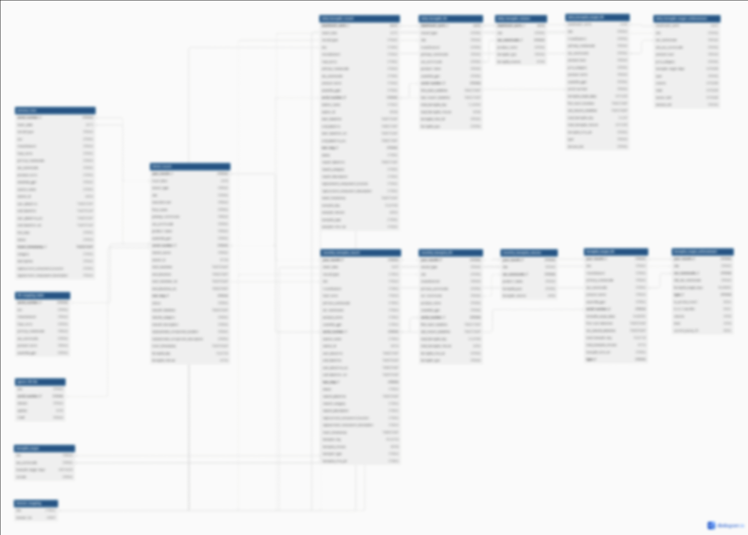
實體關係圖表
需求分析
訪談PE、ME和TE，以了解PCBA/托盤領域的專業知識，以及我們目前製造流程的業務邏輯。
資料架構設計
根據商業邏輯，我們找出了我們的來源數據，設計了包括暫存表、視圖以及這些表之間的主鍵和關係的資料倉庫。
優化並自動化我們的數據管道
使用 Cloud Composer(空氣流動)我們可以自動化我們的查詢，每兩小時更新一次我們的數據。
Notes:
Just like the demo, I think we could do more, for example we can split those documents, post, self-introduction in Beatrust platform and do word embedding and save those matrices in the vector database. That could achieve retrieval QA function for our client. If the guy ask about his paternity leave to our chatbot, then chatbot could get relative document and find the answer for him.
But there are still some task we need to do in the future, like authorization, because of data privacy, we need to add some single sign on feature before user access this chatbot.
In conclusion, I think there is demand in business or sales side and we also have ability and tech tools to build. So this kind of service has high potential and feasibility in Beatrust. Thank you. As we already knew, there’re some limitation on the official version ChatGPT now.
It couldn’t connect to internet, so you couldn’t ask him real-time question.
He had never learned your corporate information and data, so you can’t expect he could help you on your own business.
But now, this tool has revolutionary improvement, such as:
Integrate your database and answer your question as you just saw that.
He could also learn your specific information which like corporate introduction, production information
He has ability to connect internet, so you could ask him the shipping statement of your purchase.
He could do multiple task and completely understand your nature language. You don’t need to tell him “/query” is for fetch data from database, “/stock” is for search stock price in internet. That would be really easy to use for you, for your staff and for everyone.
私たちは既(すで)に知っているとおり、現在の公式版(こうしきばん)ChatGPTにはいくつかの制限(せいげん)があります。
インターネット(internet)に接続(せつぞく)することができないので、リアルタイム(real-time)の質問をすることはできません。また、ChatGPTは企業情報やデータを学(まな)んだことがないので、自分のビジネスに役立(やくだ)つのを期待することは難しいです。
しかし、今回のツールは革命(かくめい)的な進歩を達成しました。：
一つ、先見たように、企業のデータベースを統合(とうごう)し、専門問題に答えることができます。
次、企業の紹介や商品情報のような特定の情報(じょうほう)を学ぶことができます。
そして、インターネットに接続(せつぞく)するスキルがあるので、リアルタイムの情報を得ることに役に立ちます。例えば、SCMマネージャーが原材料の出荷(しゅっか)スケジュールを調べるのを手伝えます。
最後には、このアシスタントは複数(ふくすう)のタスク(task)をこなし、ユーザーの自然言語を完全に理解できます。データベースからデータを取得(しゅとく)するために「/query」を入力しないし、インターネットで株価(かぶか)を検索するために「/stock」をアシスタントに伝える必要はありません。これは、皆さんだれでも非常に使いやすいです。
だからこそ、このツールが企業内(きぎょうない)や商業用途(しょうぎょうようと)において巨大(きょだい)な潜在能力を持っていると考えています。

Slide 4



Situation
AI 革命...
2023年，由於ChatGPT的推出，日本掀起了人工智慧革命。一切都需要與人工智慧連接...
II
我
功能？
表現如何？
資料？
實施複雜度？
III
IV
Notes:
That created hundreds of action plan, no one could execute it at the same time, so we need to sort it for our client.
We use “Feasibility” as x-axis and “Emergency” as y-axis.
Each action plan will be a bubble on this Cartesian coordinate chart, the color of the bubble represents the dimensions and the size means ”Seriousness”. Then, we could get a scatter plot just like the picture.
Next step, we could divided the chart into 4 quadrants by avg. of feasibility and avg. of emergency.
The quadrant 1 means it has both high of emergency and feasibility, and you should do it ASAP.
Through this kind of action plan sorting, we could map our action plan into our blue print of digital transformation.
And this is the whole project scope.
これは全ての行動計画で、行動計画を緊急性と可能性に基づいて4つの部分に分けています。可能性と緊急性が共に高い行動計画は、必要に応じて優先的に実行されます。

